Slide 1


Engineering Drawing
Module 4
Projection of Solids
Sheba Varghese
Assistant Professor,
Dept. Of Mechanical Engineering,
Room : A (310), KJSCE, Vidyavihar
Email : sheba@somaiya.edu

Slide 2
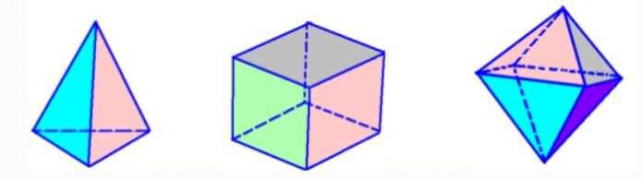
Introduction

Slide 3
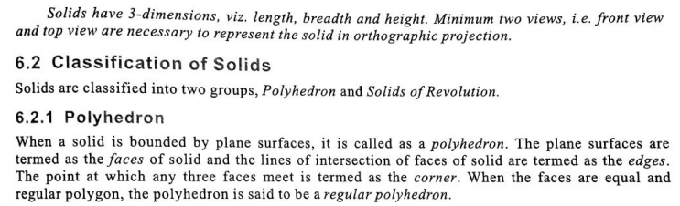
Introduction
Prism

Slide 4
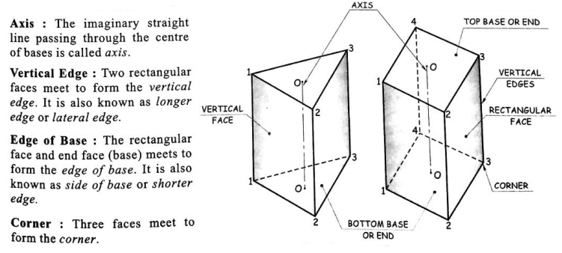
Introduction contd…

Slide 5
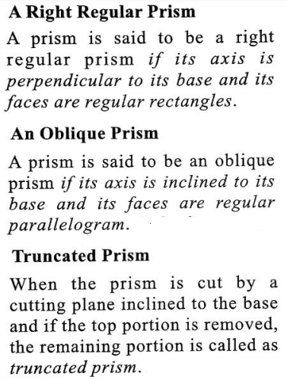
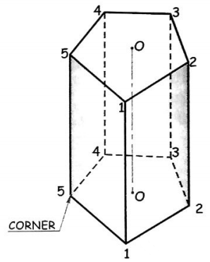
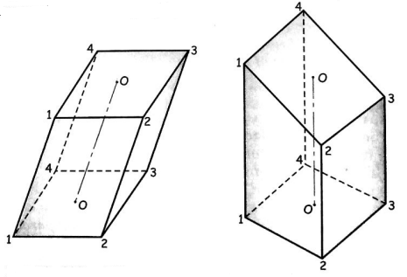
Introduction contd…

Slide 6
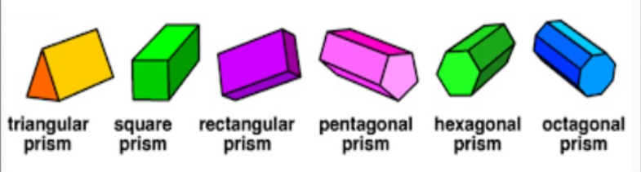
Introduction

Slide 7
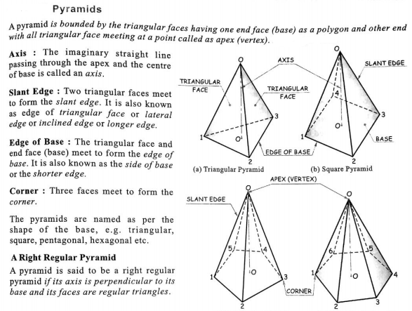

Slide 8
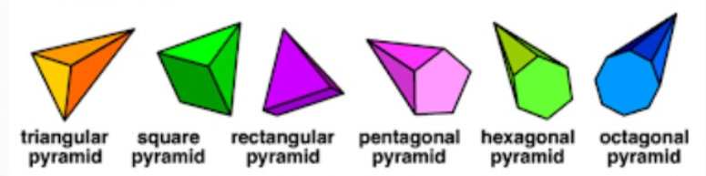
Introduction

Slide 9
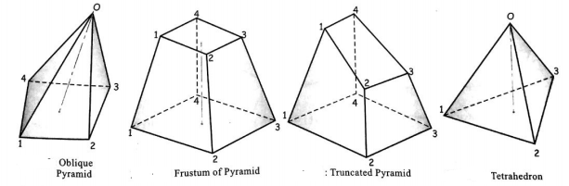
Isometric Drawing
Problem 1

Slide 10
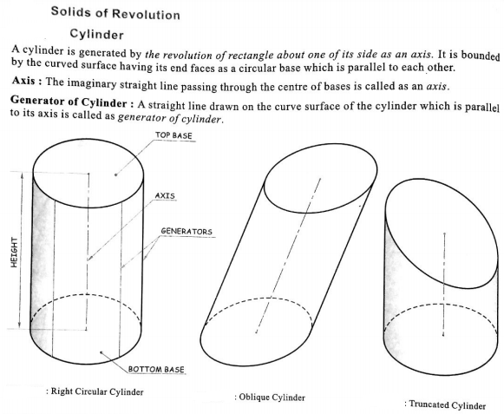

Slide 11
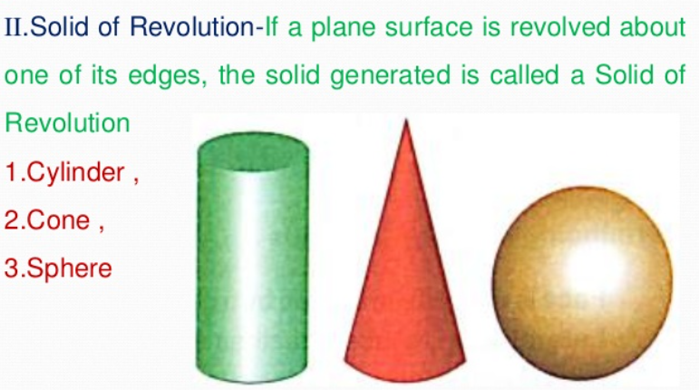
Introduction

Slide 12
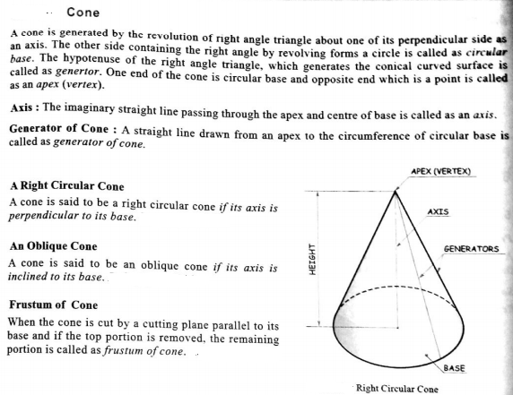
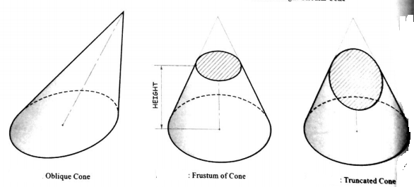

Slide 13
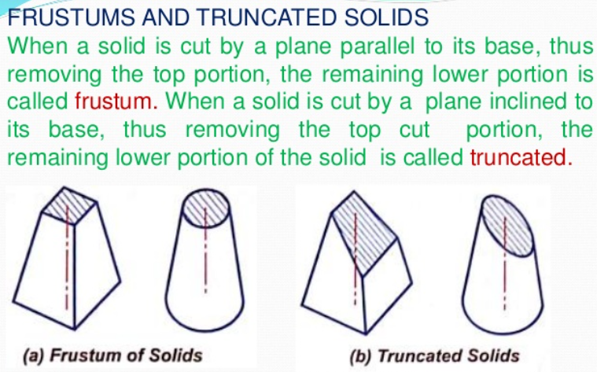
Introduction

Slide 14
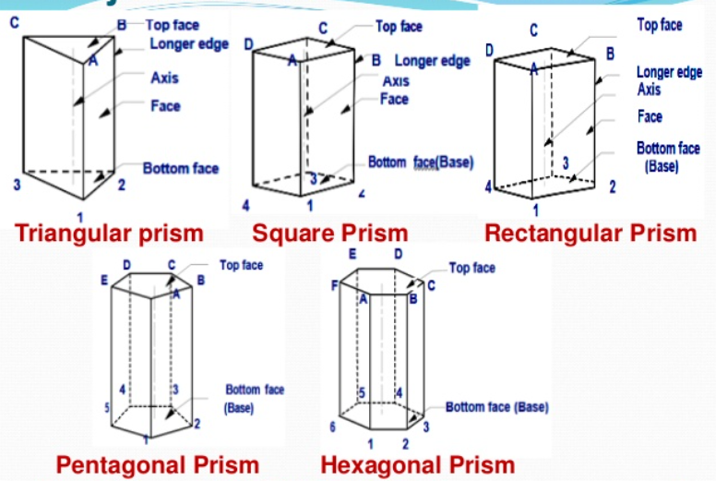
Introduction

Slide 15
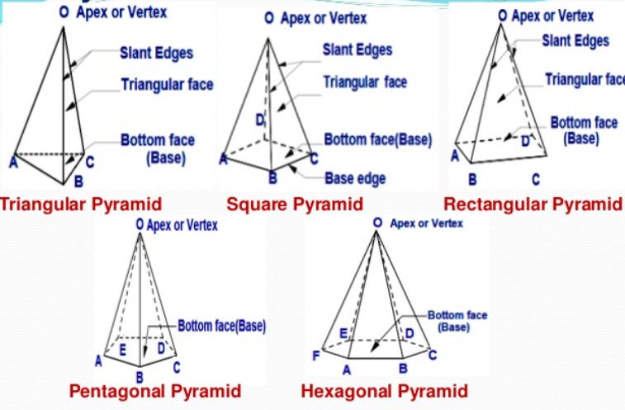
Introduction

Slide 16
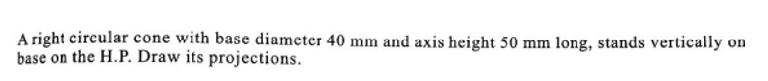
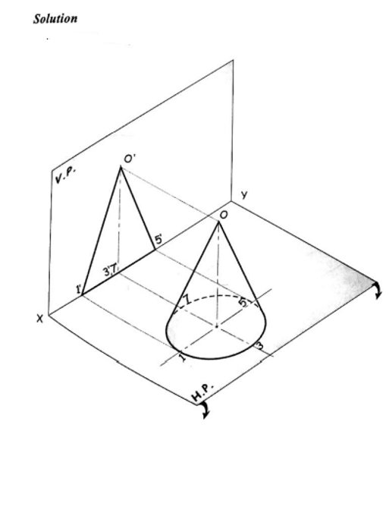
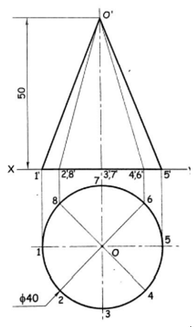

Slide 17
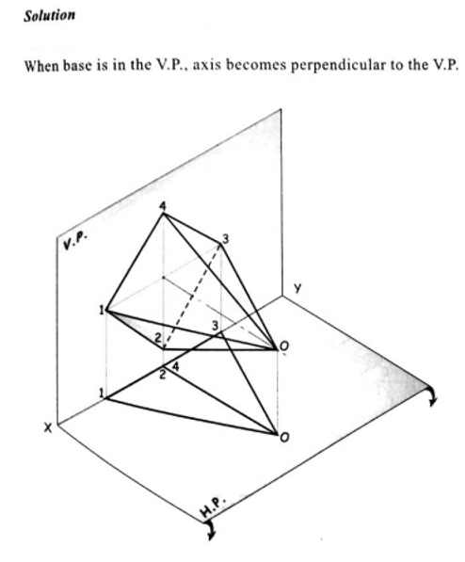
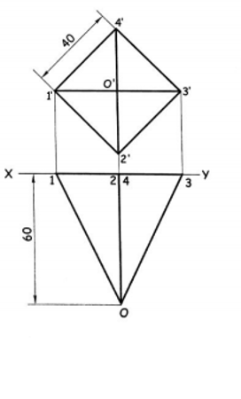

Slide 18
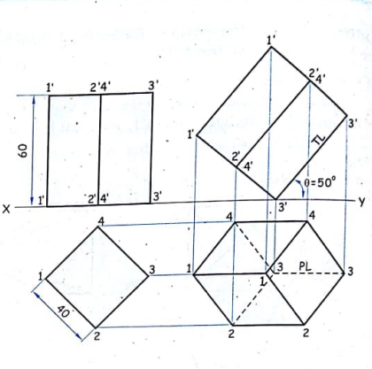
A square prism, side of base 40 mm and height 60 mm is resting on one of the corner of the base on the H.P. The longer edge containing the corner is inclined at 50° to the H.P.

Slide 19
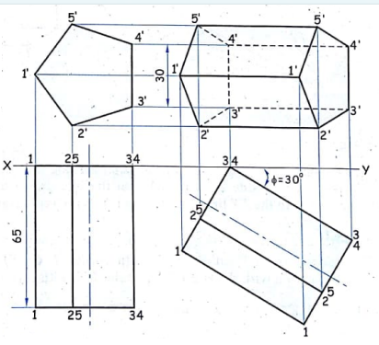
A pentagonal prism of 30 mm edge of a base and 65 mm length of an axis is having an edge of a base in the V.P. Draw the projections of a prism if the rectangular side face containing that edge is inclined at 30° to the V.P.

Slide 20
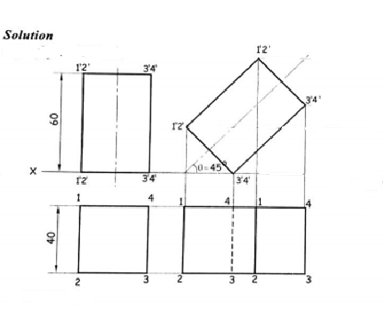
A square prism, side of base 40 mm and axis length 60 mm has one of the side of base in the H.P., which makes an angle of 45° with the H.P. Draw its projections.

Slide 21
As per the Syllabus , You have only solids inclined to one plane.
The questions in the following slides have solids inclined to both the planes.
Each questions can be considered separately one with H.P and the second with V.P or vice versa..

Slide 22
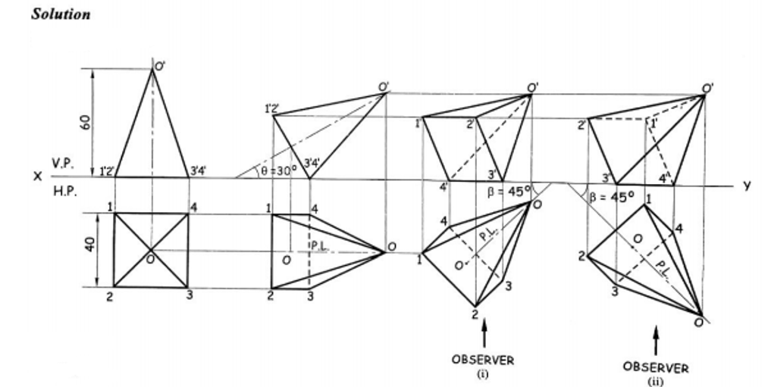

Slide 23
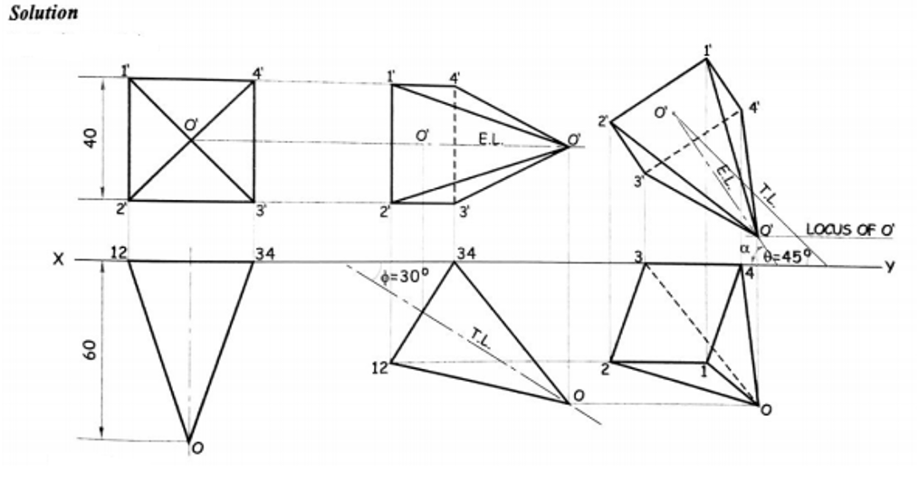

Slide 24
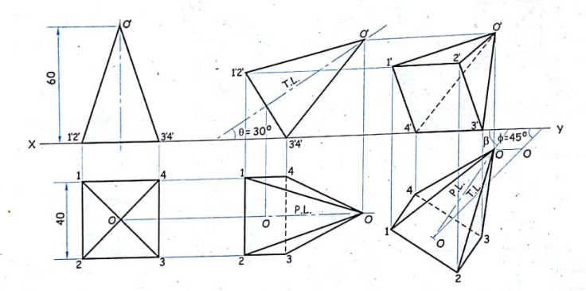

Slide 26
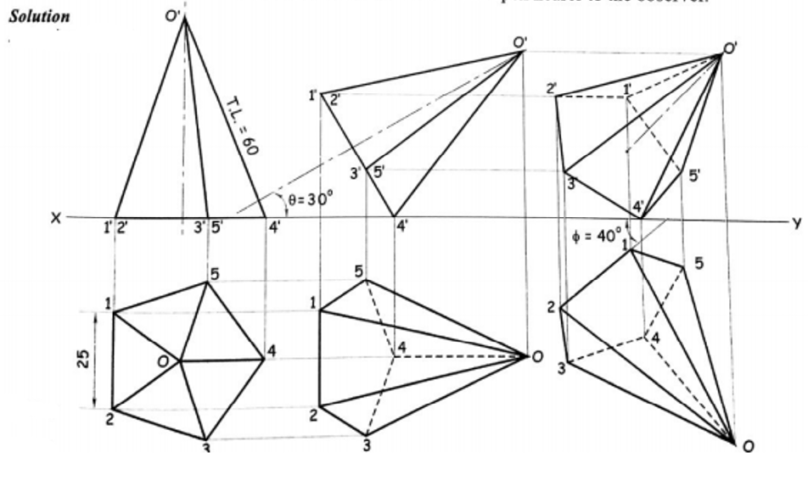

Slide 27
